Slide 1
Vision chart - simplified
From ground up

Slide 2

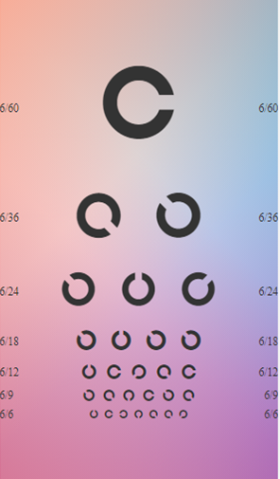

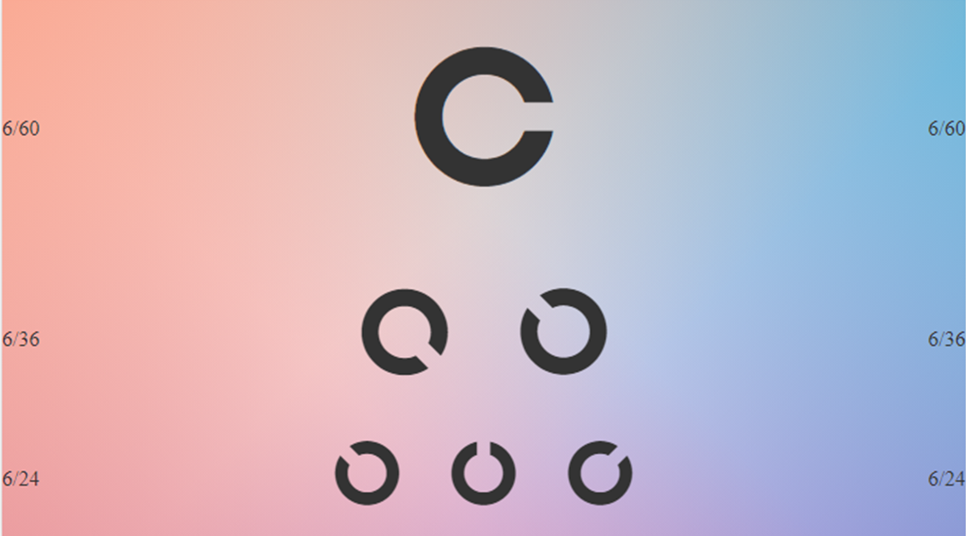
LANDOLT C
Left swipe
Button press
Right swipe
Randomise
C
E
SNELLEN
REG GREEN
NUMERICS
PEDIATRICS
REG GREEN
C
NUMERICS
E
PEDIATRICS
SNELLEN

